Slide 1
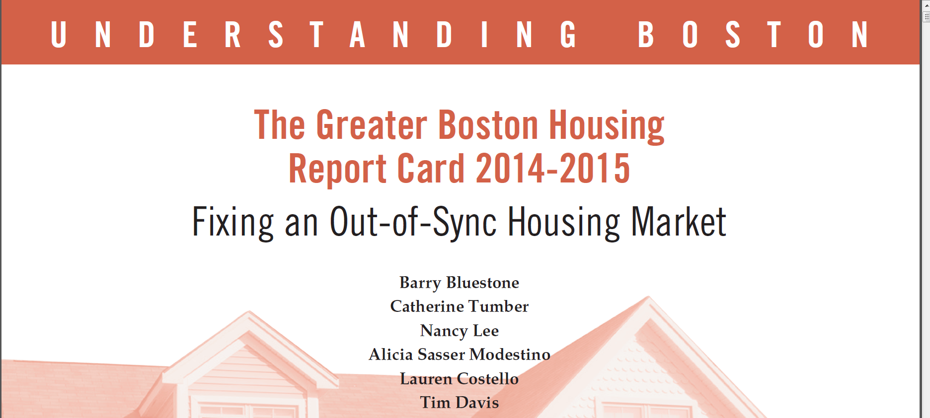


Slide 2
The Commonwealth: A Strong Economy

Slide 3
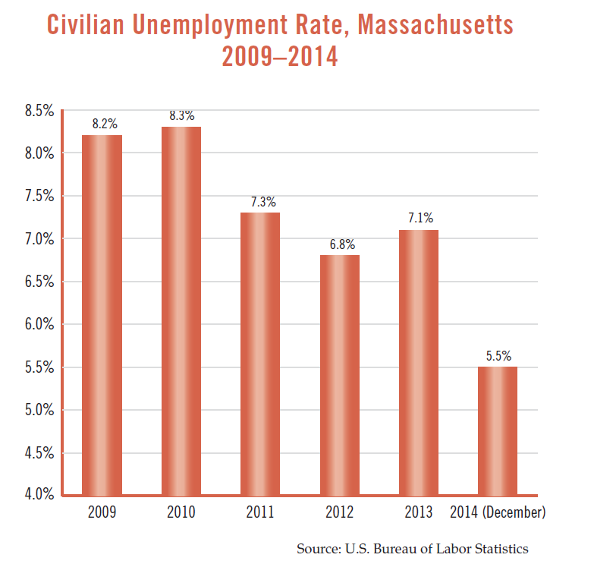

Slide 4
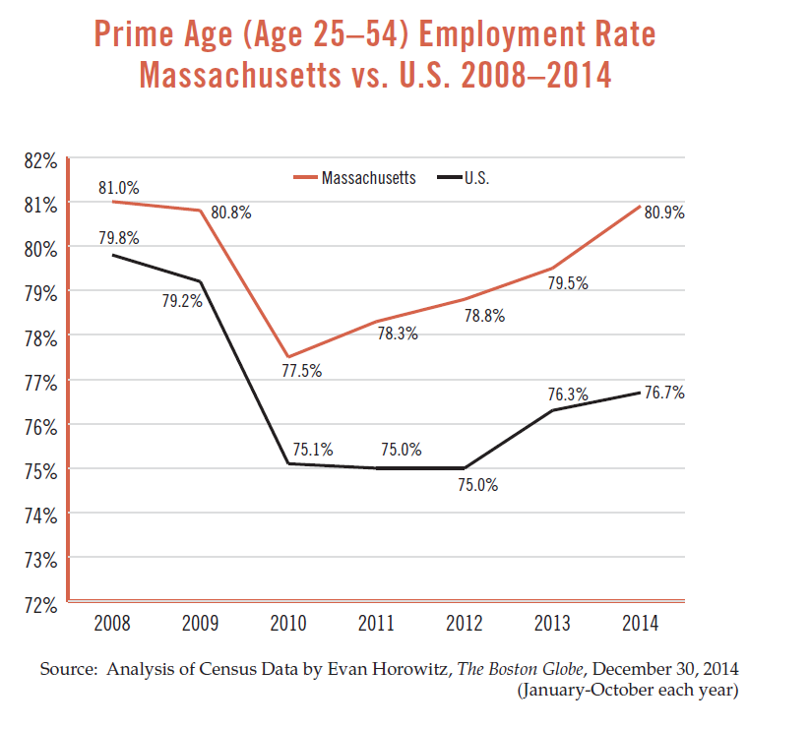

Slide 5
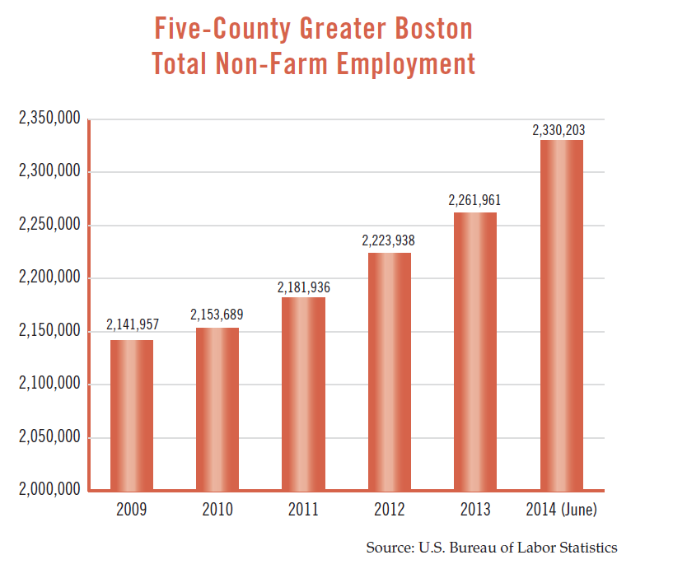

Slide 6
Demographic Revolution #1
1870-1920
Urban Development

Slide 7
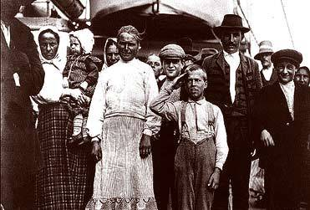
801,444
1870-1920:
Wave of Immigration
leads to tripling of
Boston’s
Population

Slide 8
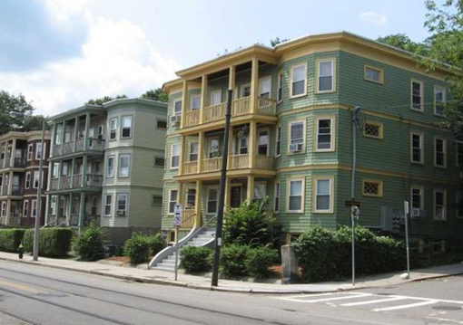
1870-1920:
The Housing Solution:
The Classic
“Triple Decker”

Slide 9
Demographic Revolution #2
1950-1980
Suburban Development

Slide 10
801,444

Slide 11
Boston’s loss was the suburb’s gain as
Central Cities emptied and suburbs blossomed

Slide 12
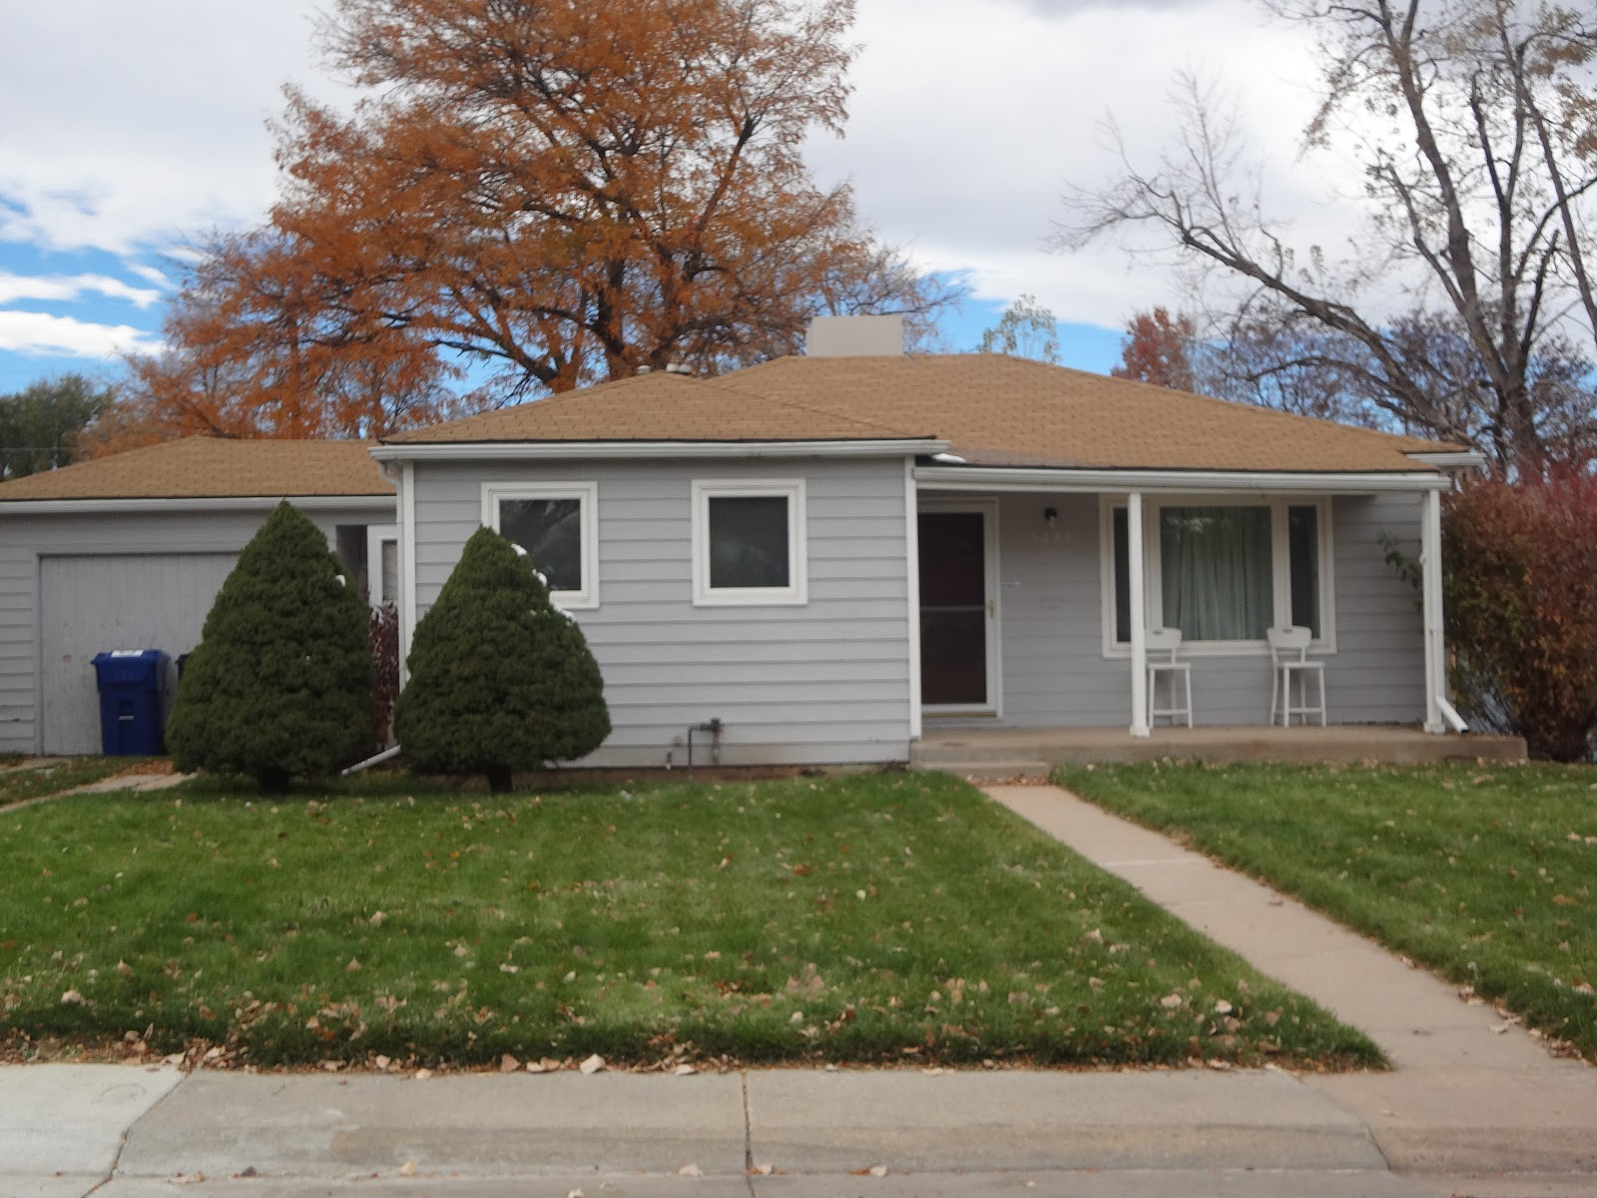
The Housing Solution: Suburban Sprawl

Slide 13
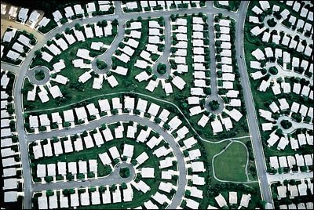

Slide 14
Demographic Revolution #3
1980-2010
2010-2030
Young Millennials
Aging Baby Boomers

Slide 15
After 1980, Boston begins to grow again
Return to the City

Slide 16
Net In-Migration
Net Out-Migration

Slide 17
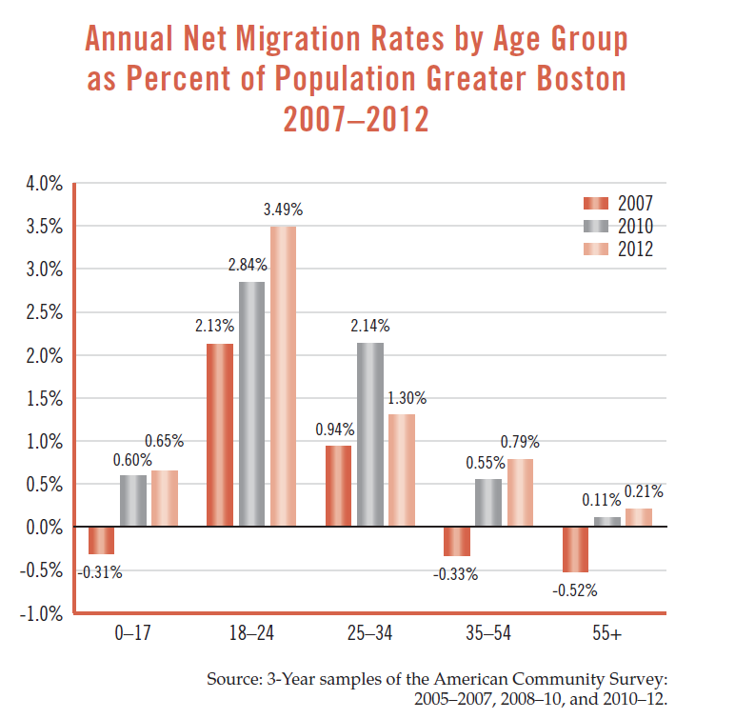

Slide 18

Boston-Cambridge-Somerville
In 2000, 20-34 year-olds comprise 34.8%
of the region’s total population
Between 2000 and 2010, 20-34 year-olds are
responsible for 73.9% of the growth in the region

Slide 20
Each year Boston now attracts
thousands of young college students …
and now many are staying

Slide 21
Triple Decker …. 1910

Slide 22

Triple Decker …. 2010

Slide 23
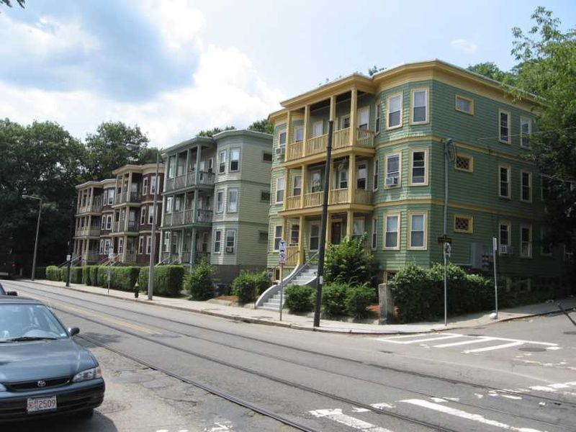
2-4 Unit Buildings … including the classic “Triple Decker” … have been the chief
housing stock for Boston-area
working families … making up
25-60% of housing stock
We need these multi-bedroom units
for Working Families
Source: U.S. Census

Slide 24
What Does the Future Hold for Greater Boston’s Demography?
2010-2030

Slide 25
Throughout Metro Boston, the next 15 years
will see an explosion in the number of aging
Baby Boomers … and continued growth
in millennials
AGE

Slide 26
U.S. Household Size 1950 - 2010
Source: U.S. Census Bureau
 | Number of Households (in 000s) | 1 Person Households | 4 or more Person Households | Average Number of Persons per Household
1950 | 43,468 | 10.9% | 37.8% | 3.37
1960 | 52,610 | 13.1% | 40.2% | 3.35
1970 | 62,874 | 17.0% | 36.9% | 3.14
1980 | 80,776 | 22.7% | 28.5% | 2.76
1990 | 93,347 | 24.6% | 25.9% | 2.63
2000 | 104,705 | 25.5% | 25.0% | 2.62
2010 | 116,716 | 27.5% | 23.0% | 2.58

Slide 27
Already, more than 60% of Greater Boston Households contain
no more than 2 persons

Slide 28
Source: MAPC
+177,000
+147,000
And tomorrow, virtually all the
growth will be among
Single Person Households and
Small Families
+8,000

Slide 29
This will mean
a huge increase
in demand for
smaller
housing units

Slide 30
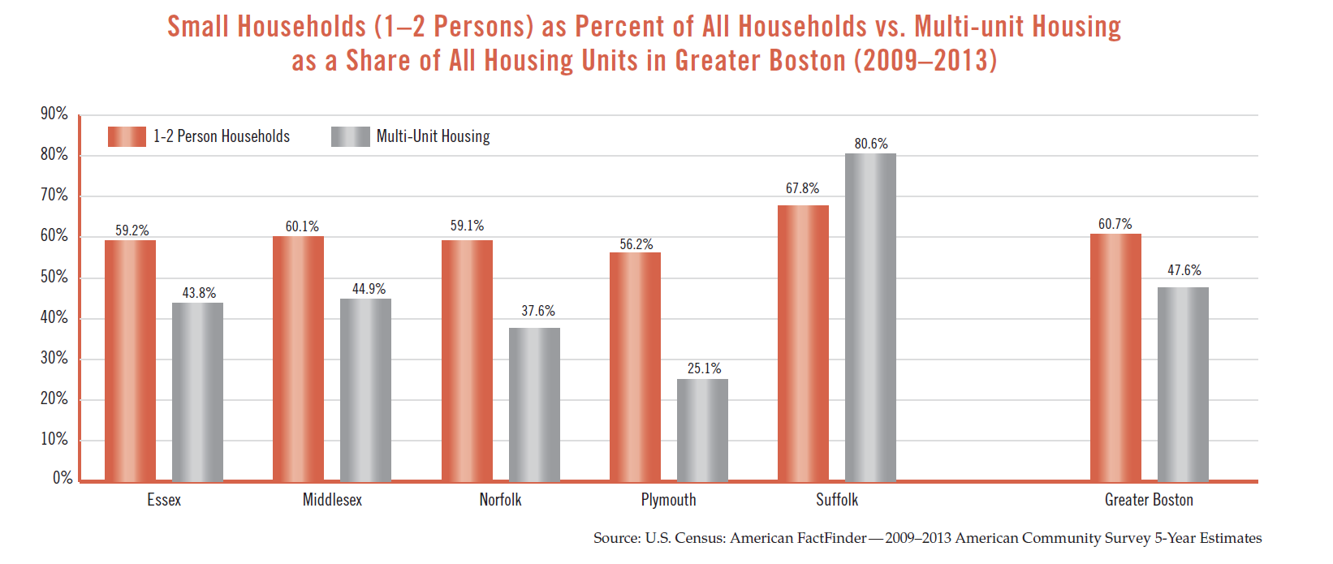

Slide 31



Need for Housing for:
Young
Millennials
Working
Families
Aging Baby
Boomers

Slide 32
Home Sales and Housing Production in Greater Boston

Slide 33
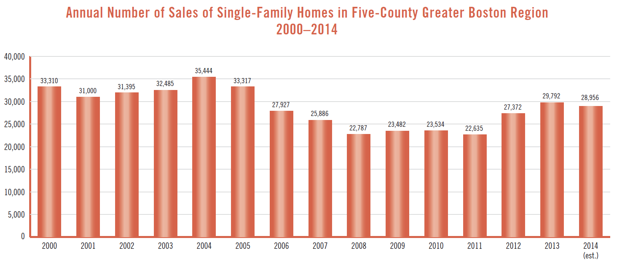

Slide 34
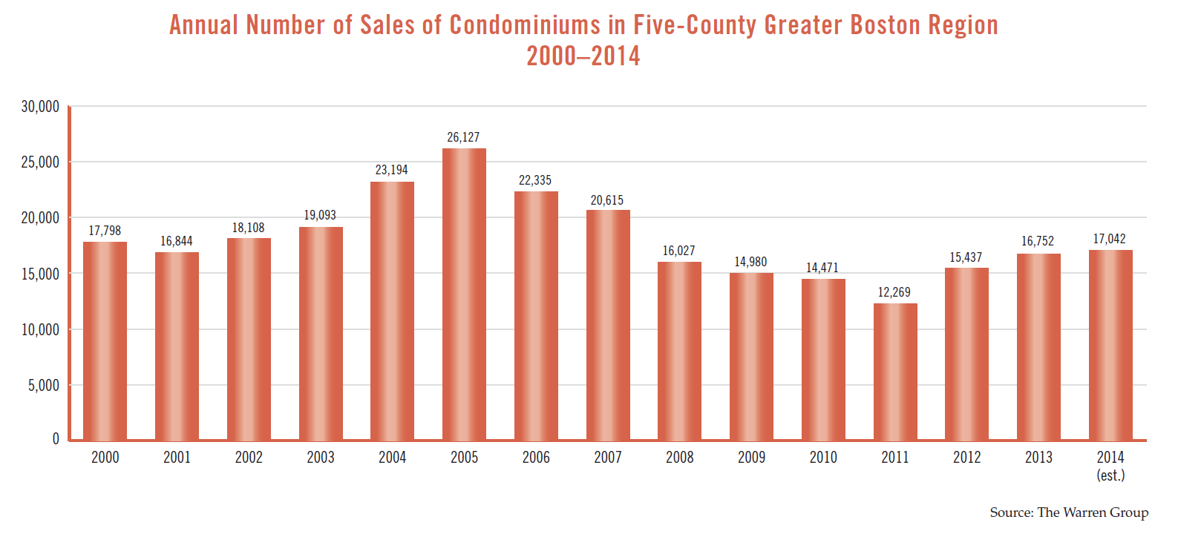

Slide 36
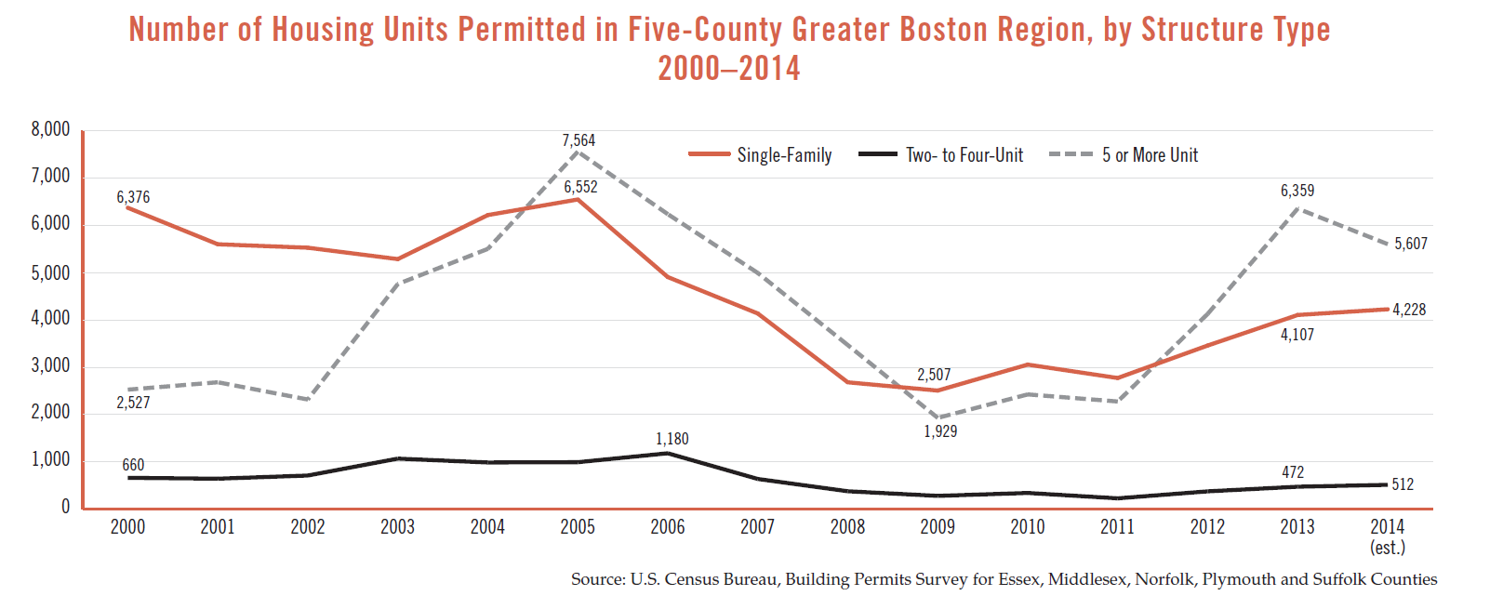
121 municipalities out of 161 did not permit any multifamily housing in 2014

Slide 37
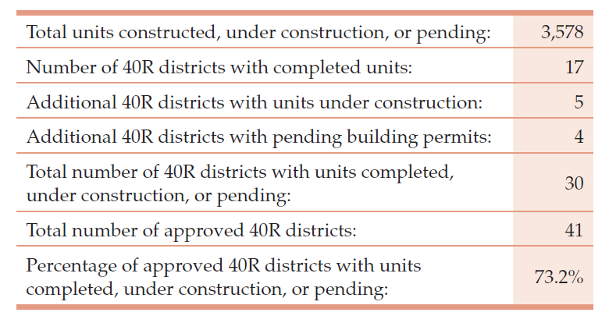
Chapter 40R Housing Production: Now adding to the Region’s New Housing Stock
97% of these units are in multi-unit structures

Slide 38
More Good News: Foreclosures Declining

Slide 40
Housing Prices and Rents in Greater Boston

Slide 41
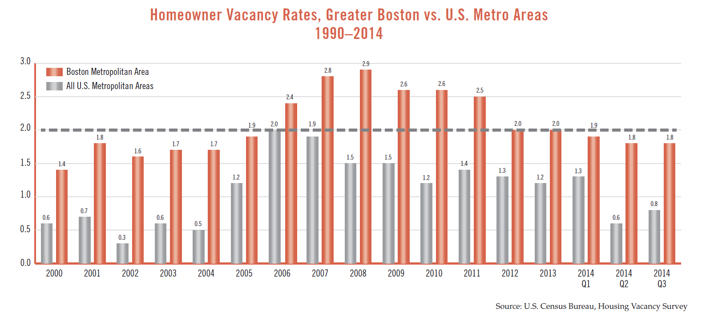

Slide 48
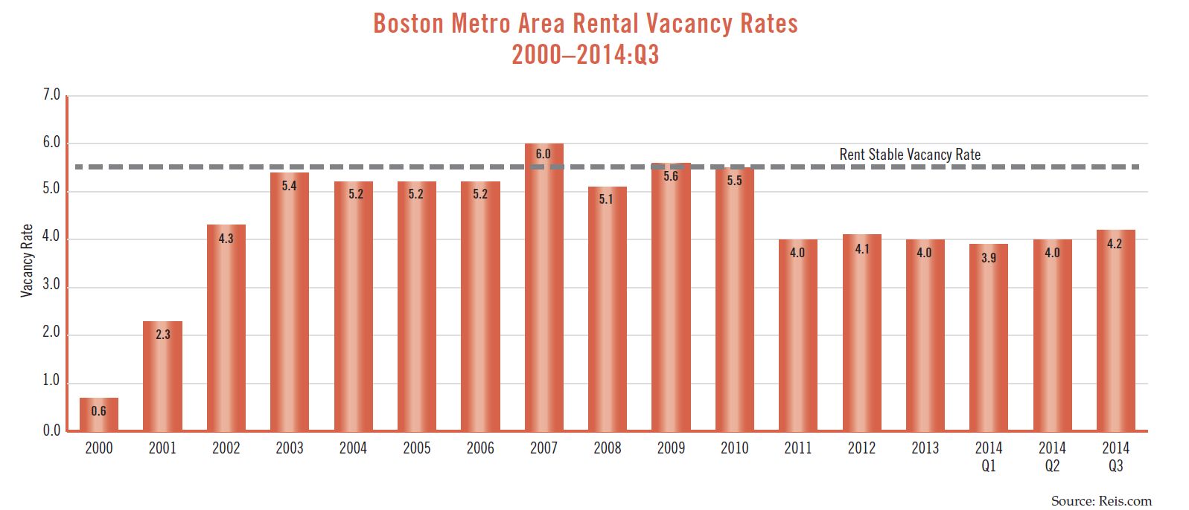

Slide 51
Since 2000, effective rents have increased 50%
faster than median renter household income …
leading to skyrocketing housing cost burdens
for Working Families

Slide 52
Rising Housing Cost Burden – Greater Boston
 | 1990 | 2000 | 2010 | 2011
Renter-Occupied Households Paying More than 30% of Income on Rent | 41.7% | 39.2% | 50.1% | 51.3%
Renter-Occupied Households Paying More than 50% of Income on Rent | 19.6% | 18.4% | 25.4% | 26.4%
Owner-Occupied Households w/ Mortgage paying More than 30% of Income on HH Costs | 28.3% | 26.7% | 39.5% | 40.4%

Slide 54
Homelessness & Housing Insecurity

Slide 55
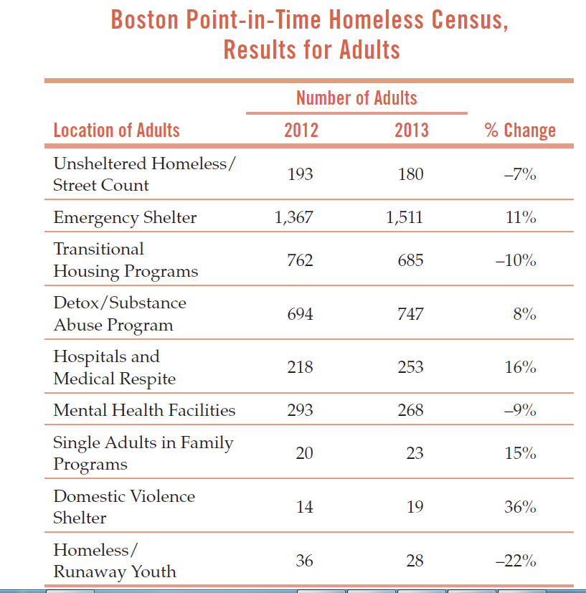

Slide 56
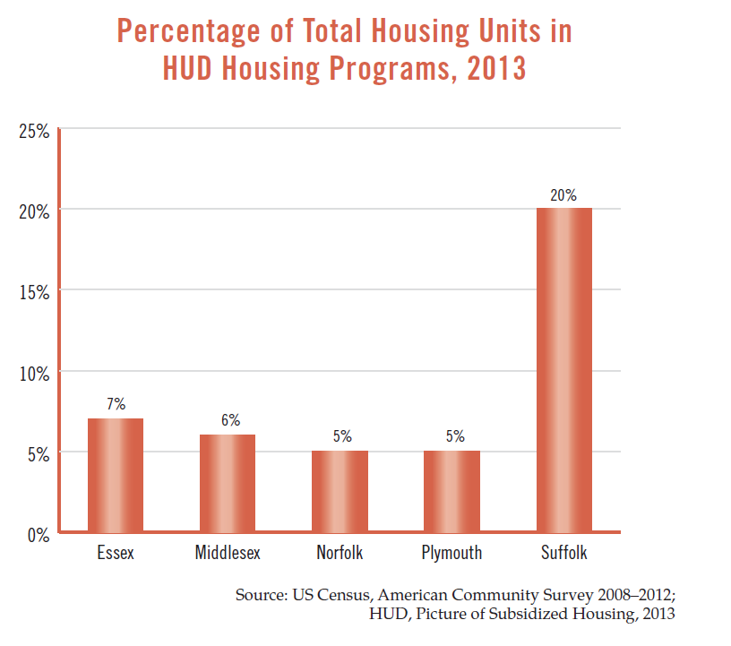

Slide 57
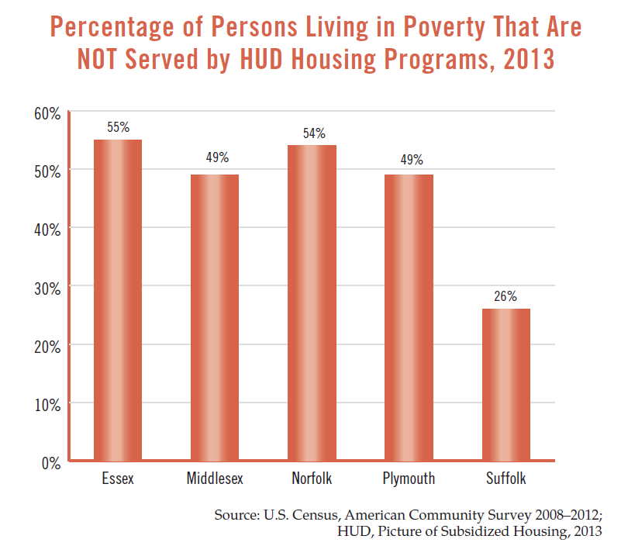

Slide 58
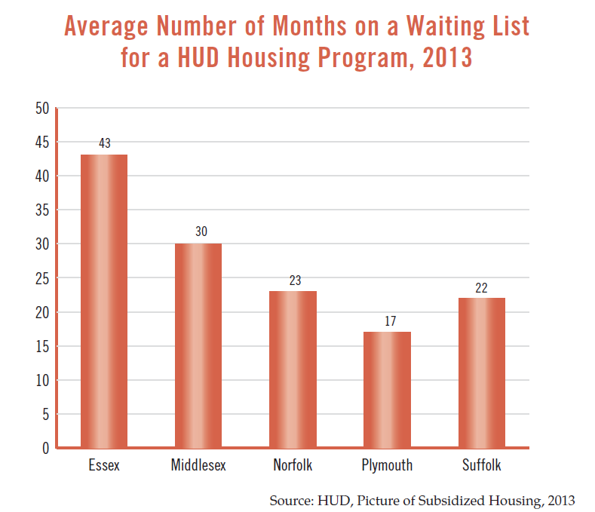

Slide 59
Funding for our Housing Needs

Slide 62
Projected Housing Needs: City of Boston

Slide 63
Mayor Marty Walsh’s Projection
Sources of New Housing Production 2010-2030
Source: Housing a Changing City: Boston 2030
Production Source | New Units
City Assisted Low-Income: Non-Senior | 6,500
City Assisted Low-Income: Senior | 1,500
Middle-Income Inclusionary/Assisted | 4,000
Middle-Income Unassisted: Non-Senior | 11,000
Middle-Income Unassisted: Senior | 2,500
Middle-Income Units Released via Dorm Production | 5,000
Market-Rate Unassisted Senior & Non-Senior | 18,500
Market-Rate Units to Support Market-Stabilizing Vacancy Rate | 4,000
Total | 53,000

Slide 64
Solving One Part of the Housing Problem
“The Millennial Village” – Housing for Graduate Students, Medical Residents & Interns, and Other Young Professionals

Slide 65
New Housing Model – “Millennial Villages”
Apartment structures -- “Millennial Villages” -- with:
  A range of units from small/”micro” apartment to studios and multi-bedroom units for graduate students, medical students, and other millennials, varying in affordability from the low income graduate student to the more well-heeled student and young professional
  Common shared space with lounges, laundry facilities, seminar rooms, study space, music practice rooms, work-out facilities, and offices that can act as small business incubators
  Ground floors to house retail establishments – a grocery store, drycleaners, coffee shop
  Roof Garden for parties and BBQ
  Near public transit where possible
  Parking for Zip Cars, bicycles
  Storage Lockers in basement

Slide 66

Making the Millennium Village Affordable
Smaller Units … including small double/triple bedrooms
Shared kitchens & common space
Limited/No parking
State/local government assistance on financing and land costs
Developer/Building Trades cost controls

Slide 67
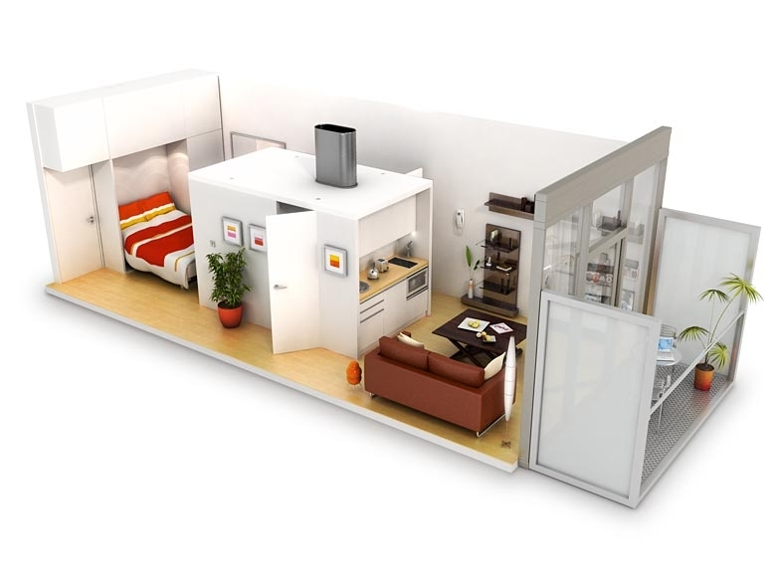
Micro Housing Unit – ADD Inc.

Slide 68
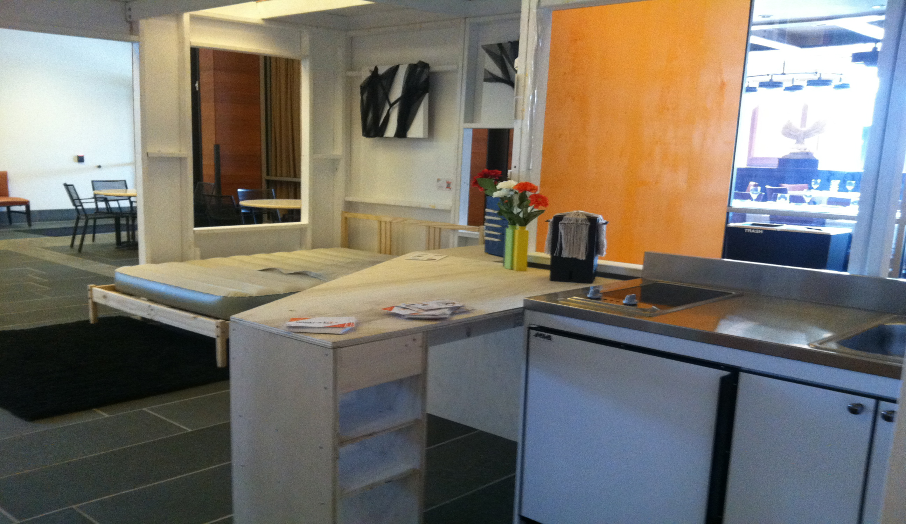
Micro Housing Unit – ADD, Inc.

Slide 69
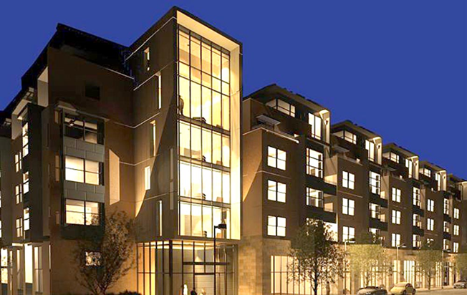
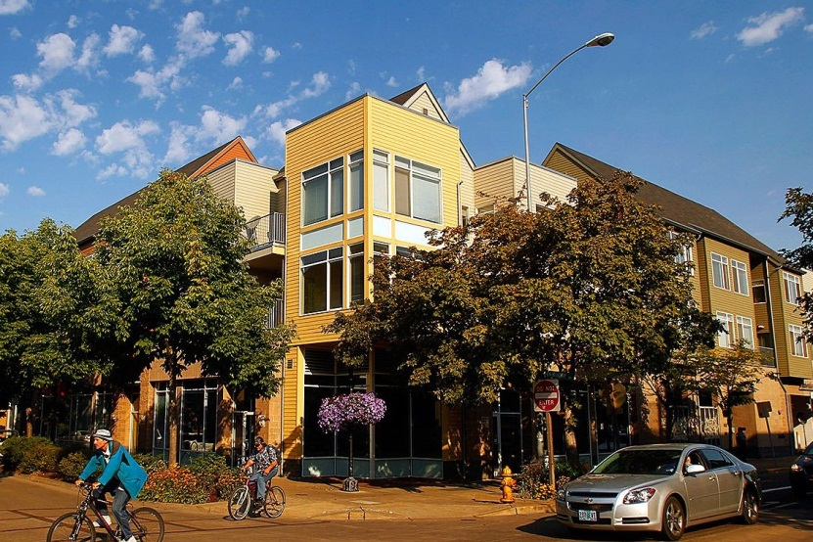
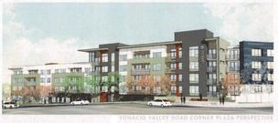
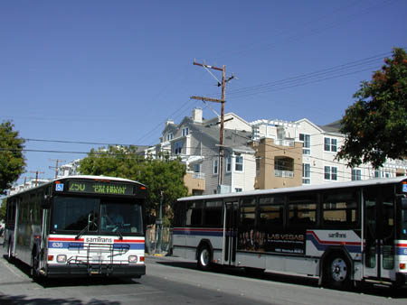
This is the New Housing we need for tomorrow

Slide 70
A New Housing Collaborative
A Role for:
Private Developers
Quasi-public & Commercial Lenders
Universities and Teaching Hospitals
Architects and Construction Firms
Unionized Building Trades
Municipal Government
State Government

Slide 71
Private Developers
The “Millennial” Housing Villages will be produced by private developers – for profit and non-profit - and these housing projects will remain on the city’s tax rolls.
In order to maintain affordability, private developers will agree to rental rates so that they make a reasonable, but not excessive, return on their investments.

Slide 72
Quasi-Public and Commercial Lenders
Massachusetts is blessed with a range of commercial lenders along with quasi-public agencies that could play a role in the financing of these “Millennial Villages” including:
  MassDevelopment
  MassHousing
  Massachusetts Housing Partnership
  Massachusetts Housing Investment Corporation

Slide 73
Universities and Teaching Hospitals
In order to assure commercial financing for these housing projects, local universities and teaching hospitals will join together and agree to master leases for most of the units in each “Millennial” Village – with each of these non-profits agreeing to take a share of these leases with the right to trade shares if necessary among themselves.
Local universities and teaching hospitals will market this housing to their graduate students, interns, and medical residents.
Units not occupied can be rented to others including recent alumni.

Slide 74
Unionized Building Trades
In order to reduce the construction costs for these “Millennial Villages”, the unionized construction trades are encouraged to provide some relief on their normal labor rates in return for producing units in a modular/panelized manufacturing facility with improved working conditions.
The construction trades will be encouraged to hire “apprentices” from inner city neighborhoods and work with the region’s vocational schools to help provide the workforce for the new housing production facility.

Slide 75
Municipal Government
In order to keep the units in these “Millennial Villages” as affordable as possible, municipal government is encouraged to:
  Reform zoning regulations to permit smaller unit sizes and allow higher density development in these housing projects
  Reduce or eliminate parking requirements given the expectation that few of these residents will have private automobiles
  Make surplus municipal-owned land available for the construction of this housing stock at a substantial reduction in market price in recognition of the public benefit accruing to the community from the construction of these units

Slide 76
State Government
In order to keep the units in these “Millennial Villages” as affordable as possible, state government is encouraged to:
  Use state bonding authority primarily through existing state quasi-public lending agencies to provide low interest loans for the production of these “Millennial Villages”
  Consider the possibility of developing a state tax credit available to private developers of these housing projects
  Make state-owned surplus land and MBTA sites available for these housing projects at a substantial reduction in market price

Slide 77
The Challenges Ahead
What can we do to assure sufficient affordable housing for
millennials, working families, and aging baby-boomers?
Millennial Villages for the Young
Free up Older Housing Stock for Working Families
Zoning Reform for appropriate housing for seniors:
Multiunit Developments
Accessory Apartments in Single Family
Homes

Slide 78
Thank You

